Slide 1


CONSUMER GOOD ANALYSIS
Presented by: Nachiketa Mandal

Slide 2
About AtliQ Hardwares and Problem Statement
AtliQ Hardware (imaginary company) is one of the leading computer hardware producers in India and well expanded in other countries too.
The management noticed that they do not get enough insights to make quick and smart data-informed decisions. They want to expand their data analytics team by adding several junior data analysts. Tony Sharma, their data analytics director wanted to hire someone who is good at both tec h and soft skills. Hence, he decided to conduct a SQL challenge which will help him understand both the skills.

Slide 3
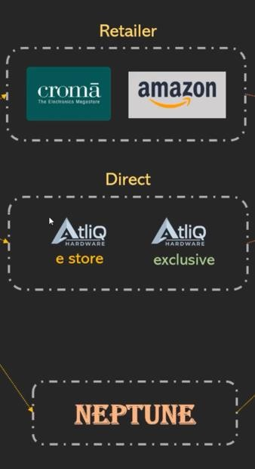
AtliQ Hardware – Business Model
Customers Channels
Customers
Customer Platforms
Croma
Brick and Mortar
E-Commerce
Best Buy
Croma
Best Buy
Amazon
Flipkart
Staples
Flipkart

Slide 4
1.Question
Provide the list of markets in which customer “AtliQ Exclusive” operates its business in the APAC region.
Output
Select
Distinct market
From dim_customer Where customer = “AtliQ Exclusive” And region = “APAC” ;

Slide 5
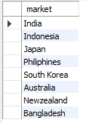
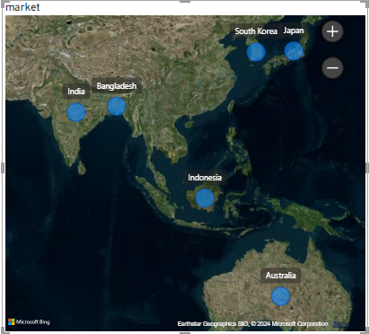
Atliq Exclusive’s’ market in ‘APAC’ region
Insight
1. Atliq Exclusive operate in eight countries within the APAC region.

Slide 6
2.Question
What is the percentage of unique product increase in 2020 vs 2021? The final output contains these fields, unique_products_2020 , unique_products_2021, percentage_chg
Output
With
x as ( select
count(product_code) as unique_products_2020
from fact_gross_price
where fiscal_year = 2020 ) ,
y as ( select
count(product_code) as unique_products_2021
from fact_gross_price
where fiscal_year = 2021 )
select
x.unique_products_2020,
y.unique_products_2021,
round((y.unique_products_2021 - x.unique_products_2020) *
100/ y.unique_products_2021,2) as percentage_chg
from x , y ;

Slide 7

Yearly Product growth Analysis
26.65%
Insights
The number of unique product grow 245 in 2020 to 334 in 2021 increasing 26.65%
The significant increase highlight that company full fill customer needs.

Slide 8
3.Question
Provide a report with all the unique product counts for each segment and sort them in descending order of product counts. The final output contains 2 fileds , segment , product_count
Output
Select
segment ,
count(distinct product_code) as product_count
from dim_product
group by segment
order by product_count desc
;

Slide 9
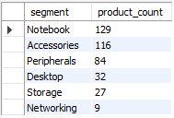
Unique Product Analysis for segment
Insights
In AtliQ 82.87% product verities in Notebook, Accessories, Peripherals segment
Desktop, Storage, Networking segment holding 17.13% product verities.
AtliQ should focus on Desktop, storage, Networking segment build them acrosidng customer needs

Slide 10
4.Question
Follow-up: Which segment had the most increase in unique products in 2021 vs 2020 ? The final output contains these fields, segment, product_count_2020, product_count_2021, difference.
Output
With x as (select p.segment, count(distinct p.product_code) as product_count_2020
from dim_product p
join fact_gross_price g
on p.product_code = g.product_code
where g.fiscal_year = 2020
group by segment
order by product_count_2020 desc),
y as (select p.segment, count(distinct p.product_code) as product_count_2021
from dim_product p
join fact_gross_price g
on p.product_code = g.product_code
where g.fiscal_year = 2021
group by segment
order by product_count_2021 desc)
Select x.segment, x.product_count_2020, y.product_count_2021,
y.product_count_2021-x.product_count_2020 as difference
From x
left join y
on x.segment = segment
order by difference desc ;

Slide 11
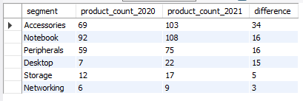
Year Product growth analysis in segment
Insight
Accessories have the most increased products from 2020 to 2021, with an increase of 34 new products.
Notebook, Peripherals and Desktop increased products from 2020 to 2021 , with an increase of 16 and 15 new products
Storage and Networking segments are producing the least new products from 2020 to 2021

Slide 12
5.Question
Get the products that have the highest and lowest manufacturing costs. The final output should contain these fields, product_code, product, manufacturing_cost .
Output
With cost_summary as (
select
max(manufacturing_cost) as max_cost,
min(manufacturing_cost) as min_cost
from fact_manufacturing_cost )
Select
p.product_code, p.product,
m.manufactureing_cost
From dim_product p
Join fact_manufacturing_cost m
on p.product_code = m.product_code
Join cost_summary cs
on m.manufacturing_cost = cs.max_cost
or m.manufacturing_cost = cs.min_cost
Order by manufacturing_cost desc ;

Slide 13

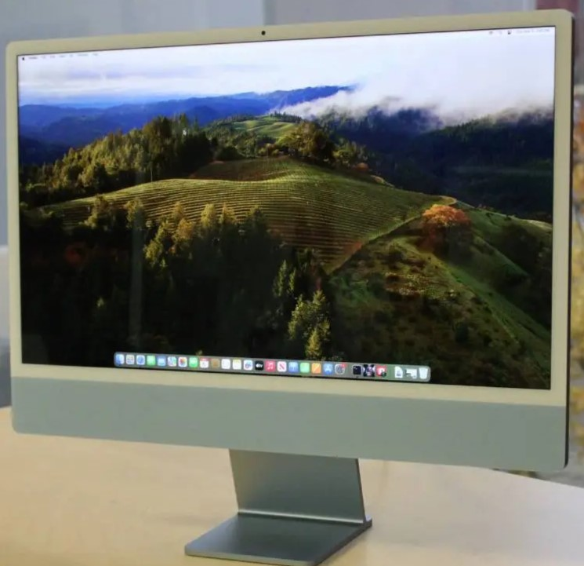

Analysis of Products with the Highest and Lowest Manufacturing Costs
$240.54
$0.89
Mouse
Personal Desktop
A2118150101
A6120110206
AQ Master Wired x1 Ms
AQ HOME Allin 1 Gen 2

Slide 14
6.Question
Generate a report which contains the top 5 customers who received an
average high pre_invoice_discount_pct for the fiscal year 2021 and in the
Indian market. The final output contains these fields, customer_code ,customer average_discount_percentage
Output
select
c.customer_code,
c.customer,
round(avg(pre.pre_invoice_discount_pct), 2) as average_discount_percentage
from dim_customer c
join fact_pre_invoice_deductions pre
on c.customer_code = pre.customer_code
where pre.fiscal_year = 2021 and c.market =“India”
group by c.customer_code, c.customer
order by average_discount_percentage desc
limit 5;

Slide 15
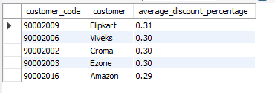
Top 5 Avg Pre-Inv Discount Customers: India FY 2021
Insights
AtliQ give the highest avg_discount_percentage 31.00% to Flipkart.
Viveks, Croma, Ezone, Amazon get similar avg_discount_percentage 30% and 29%

Slide 16
7.Question
Get the complete report of the Gross sales amount for the customer “Atliq
Exclusive” for each month. This analysis helps to get an idea of low and
high-performing months and take strategic decisions.
The final report contains these columns: Month, Year, Gross sales Amount
Output
select
month (date_add (s.date, interval 4 month)) as month,
year (date_add(s.date, interval 4 month)) as year,
sum(s.sold_quantity*g.gross_price) as gross_sales
from fact_sales_monthly s
join fact_gross_price g
on s.product_code = g.product_code
join dim_customer c
on s.customer_code = c.customer_code
where c.customer = “Atliq Exclusive”
group by year, month
order by year, month ;

Slide 17
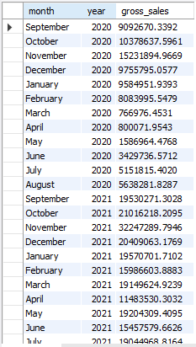
Monthly Gross Sales Analysis: Atliq Exclusive
Insight
In March, April, May month recored lowest sales due to the COVID-19 pendemic. Show small growth in june.
November month generated the highest sales for 2020 and 2021
April and August month generated the lowest sales for 2021

Slide 18
8.Question
In which quarter of 2020, got the maximum total_sold_quantity? The final
output contains these fields sorted by the total_sold_quantity, Quarter,
total_sold_quantity
Output
select
case
when month (date) in (9,10,11) then “Q1”
when month(date) in ( 12, 1, 2) then “Q2”
when month(date) in (3, 4, 5) then “Q3”
else “Q4”
end as quarter,
sum(sold_quantity) as total_sold_quantity
from fact_sales_monthly
where fiscal_year = 2020
group by quarter
order by total_sold_quantity ;

Slide 19

Max Sold Quantity by Quarter: 2020
Insights
Q1(2020) AtliQ creaded highest sales 7005619 , showing the storng performance early in the year
Q3(2020) AtliQ recored lowest sales 2075087 due to the covide-19 pendamic but in Q4 showing slow growth .

Slide 20
9.Question
Which channel helped to bring more gross sales in the fiscal year 2021
and the percentage of contribution? The final output contains these fields,
Channel, gross_sales_mln, percentage
Output
with channel_sales as ( select c.channel,
round(sum(s.sold_quantity * g.gross_price) / 1000000, 2) as gross_sales_mln
from fact_sales_monthly s
join fact_gross_price g
on s.product_code = g.product_code
join dim_customer c
on s.customer_code = c.customer_code
where s.fiscal_year = 2021
group by c.channel ),
total_sales as ( select sum(gross_sales_mln) as total_sales
from channel_sales)
select cs.channel, cs.gross_sales_mln,
round(cs.gross_sales_mln / ts.total_sales) *100, 2) as percentage
from channel_sales_mln cs
cross join total_sales ts
order by cs.gross_sales_mln desc ;

Slide 21

Top Sales Channel Contribution: FY 2021
Insight
Direct and Distributor channel together contributes onlly 26.79% of total_gross_sales.
Retailer channel in AtliQ contributing highest sales 73.22% of total_gross_sales.

Slide 22
10.Question
Get the Top 3 products in each division that have a high total_sold_quantity in the fiscal_year 2021? The final output contains these fields, division, product_code,
product, total_sold_quantity, rank_order
Output
with ranked_products as (
select p.division, p.product_code,
sum(s.sold_quantity) as total_sold_quantity,
rank() over(
partition by p.division
order by sum(s.sold_quantity) desc) as top
from fact_sales_monthly s
join dim_product p
on s.product_code = p.product_code
where s.fiscal_year = 2021
group by p.division, p.product_code )
select division, product_code
from ranked_products
where top <= 3
order by division, top ;

Slide 23
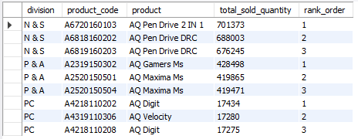
Top 3 Products by Sales Quantity: FY 2021 by Division
Insight
In the N & S division , pen drives dominates the top three slots.
In the P & A division, Mouse captured top three position .
In the PC division best selling products are laptop

Slide 24
